Slide 1
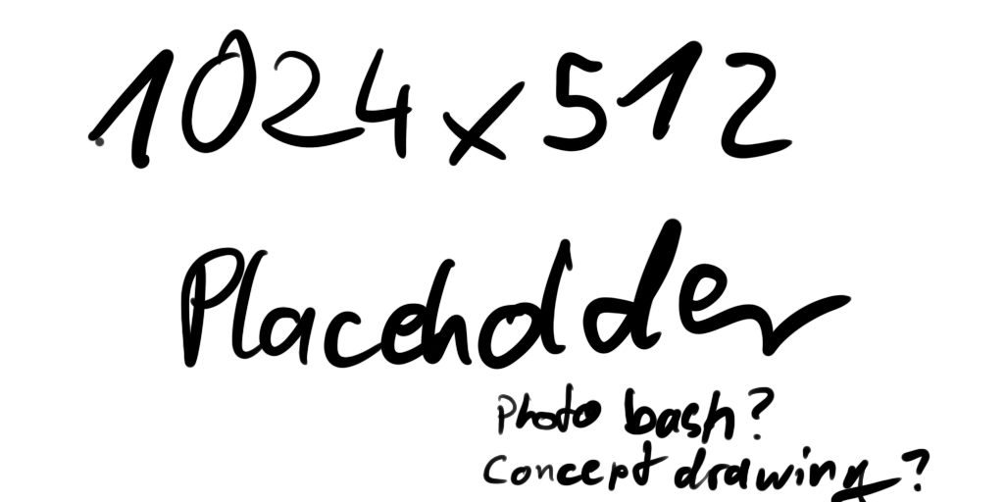
Zephyr Roth
Team Outworlders
17.11.23

Slide 2
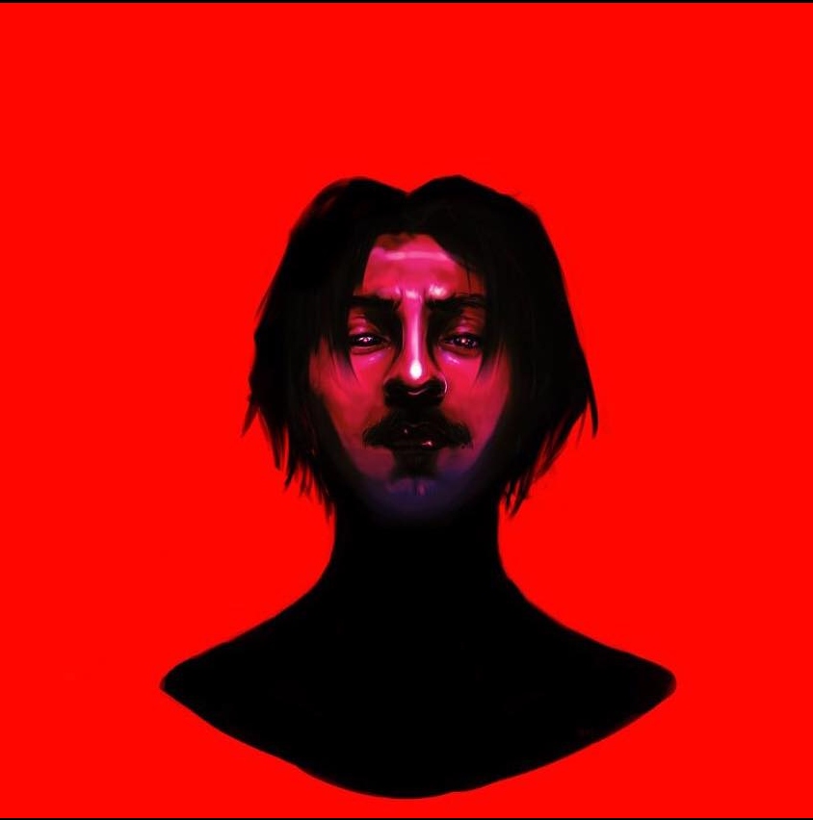
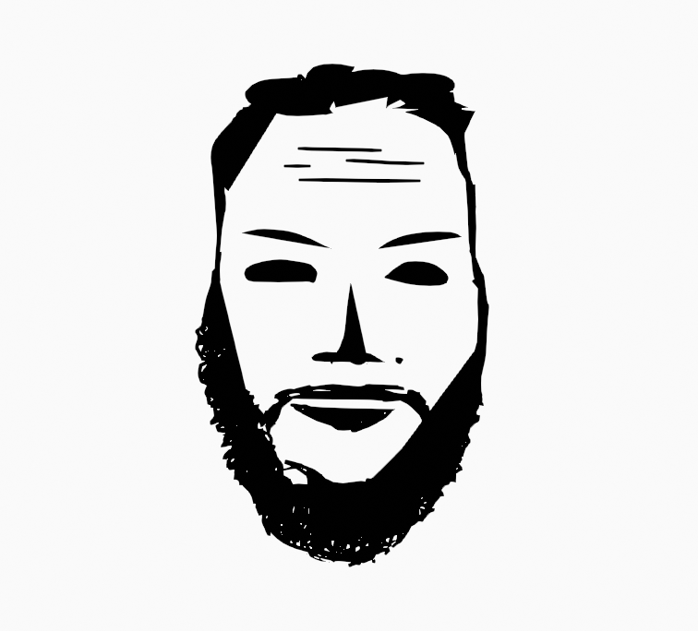
The Outworlders
Mutlu Yakubov
Mutialtanov@gmail.com
Discord: Muti
Alina Leonteva
alinaleo3d@gmail.com
Discord: alina_leo
Noah Wendt
noahwendt@gmx.de
Discord: Haon.Tnev

Slide 3
Concept
Environment
Characters
Gameplay
Spire enveloped in wind
Floating islands
Strange shapes
Little vegetation
Highly advanced form of life
Gloomy
Foreign to Environment
Light Platforming
Basic collectibles
Reach the top
17.11.23

Slide 4
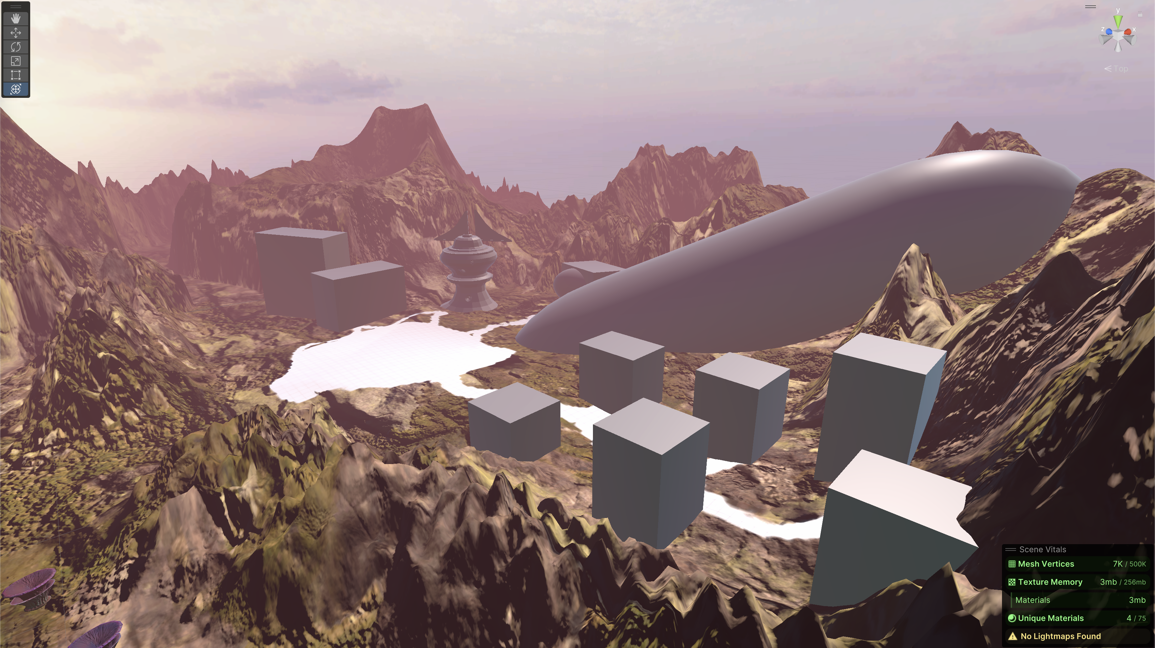
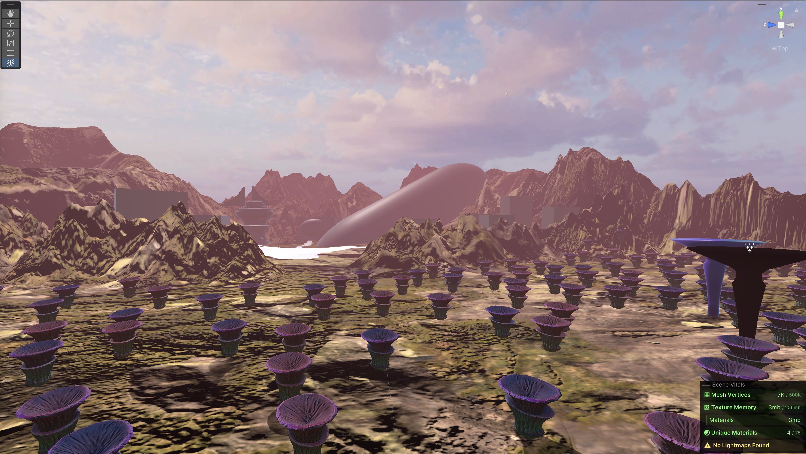
Initial Environment
17.11.23

Slide 5
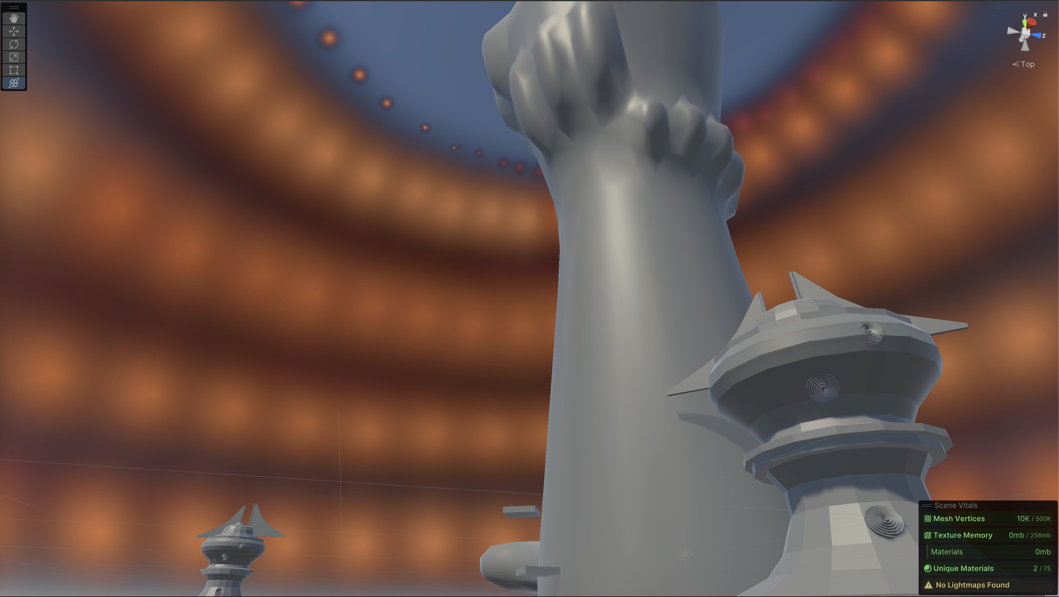
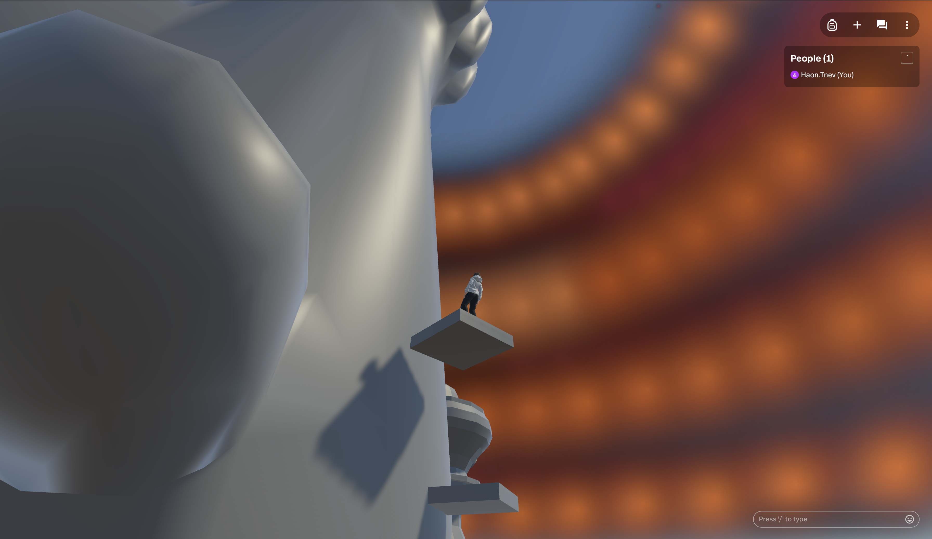
New Environment
17.11.23

Slide 6
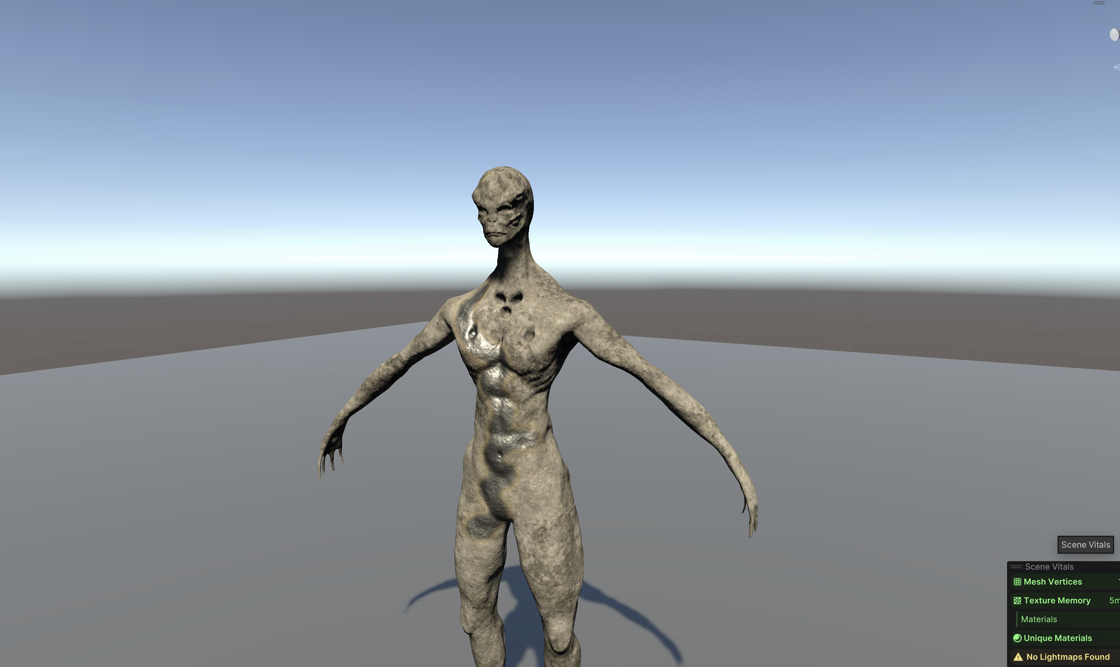
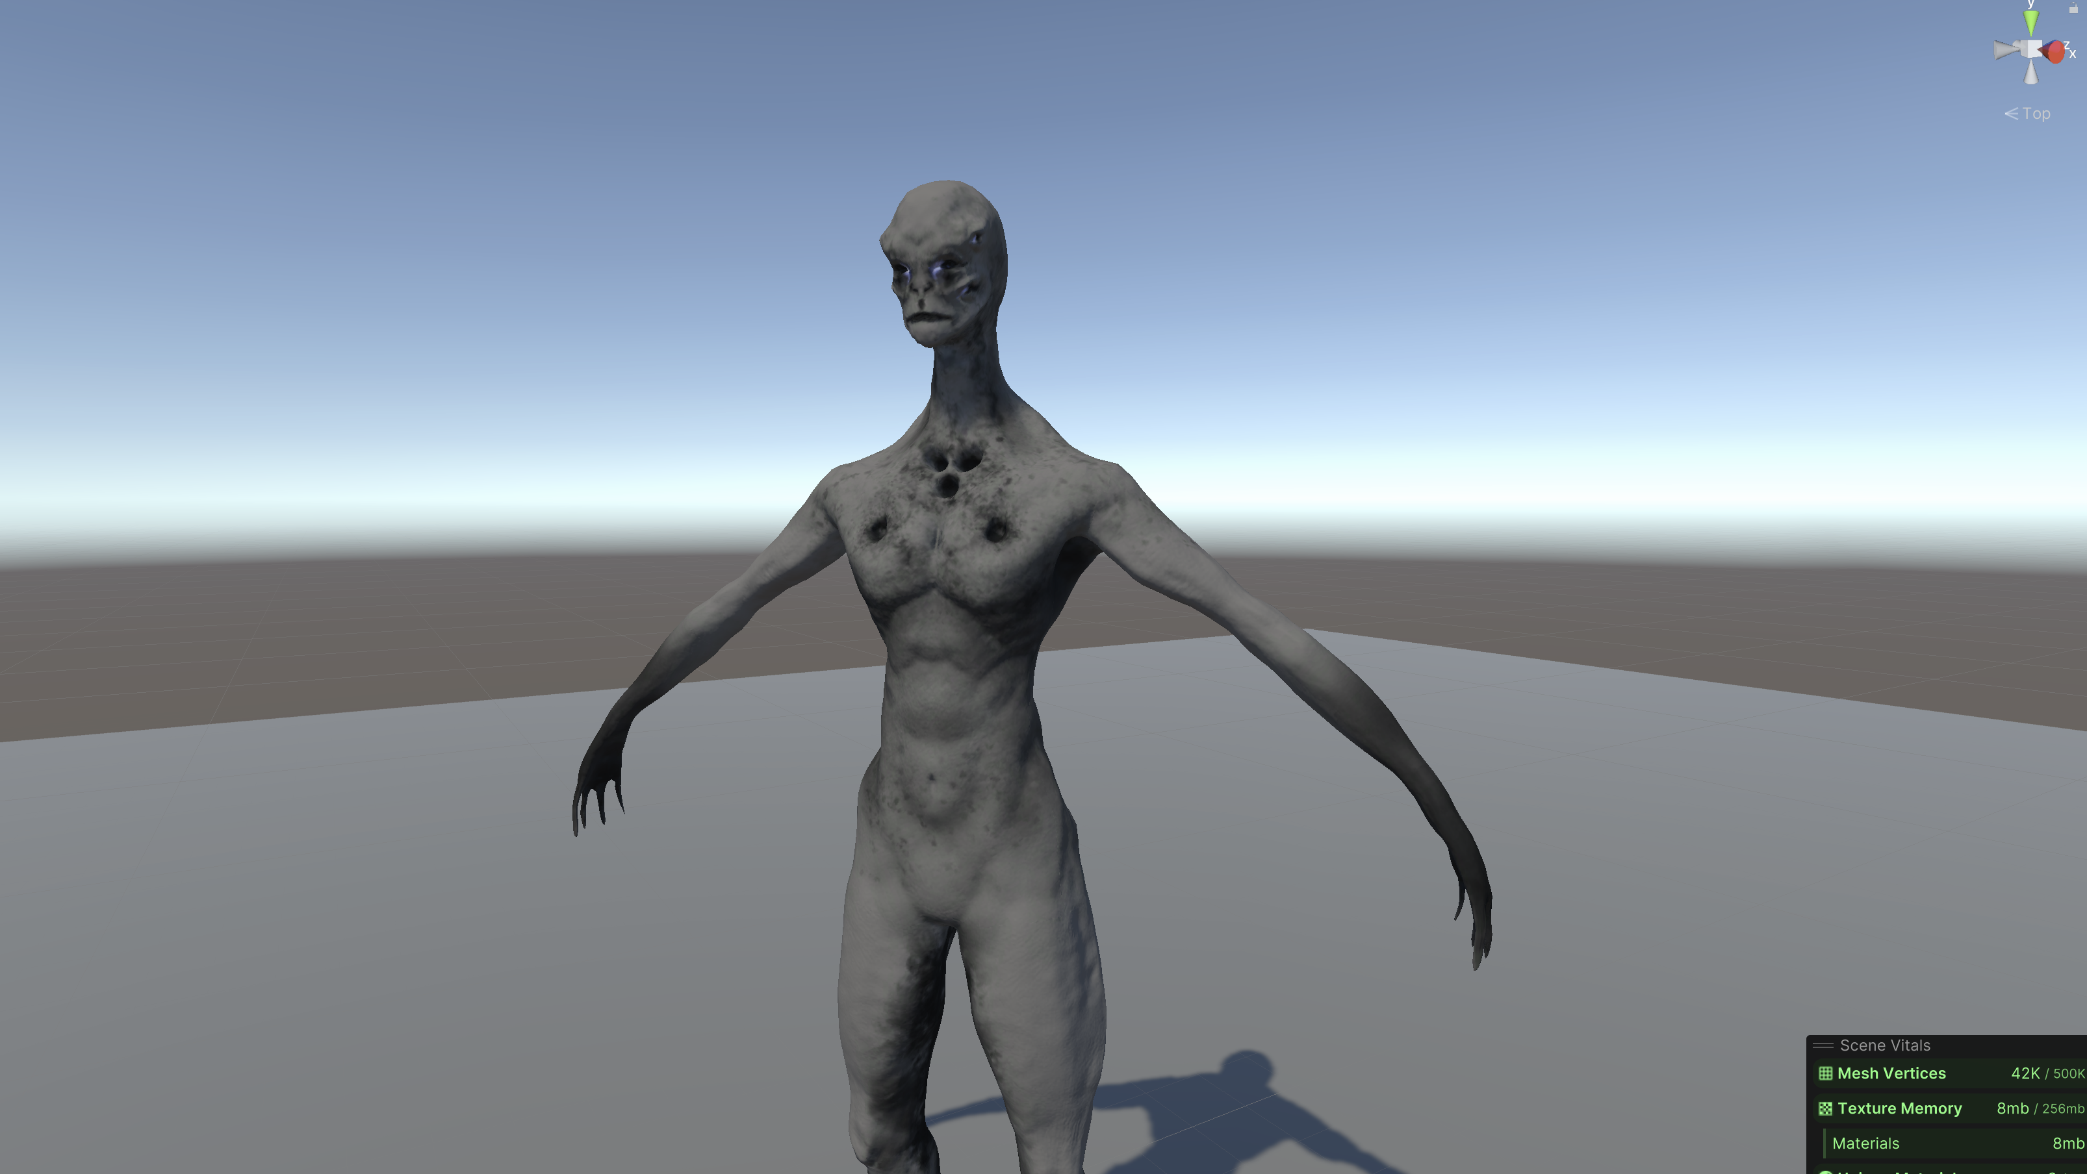
Characters
17.11.23

Slide 7
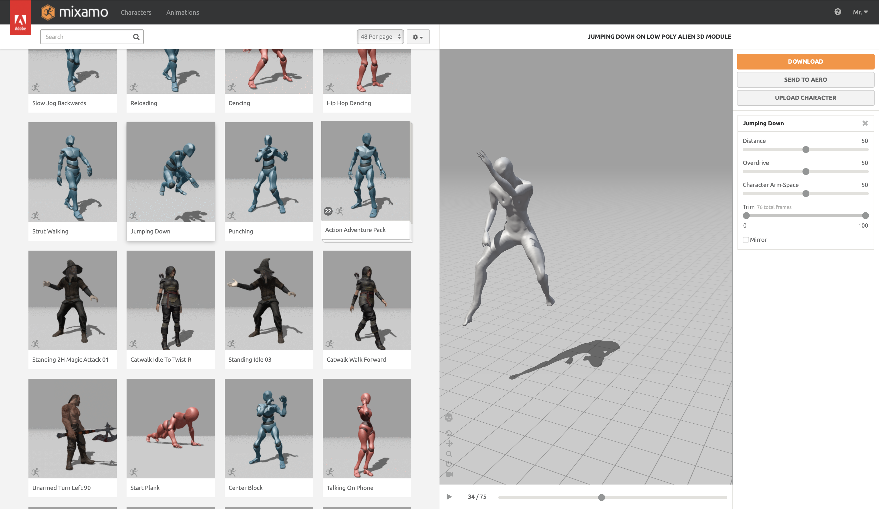
Characters
17.11.23

Slide 8
Thank you
for your attention!
👽
17.11.23

